Slide 1
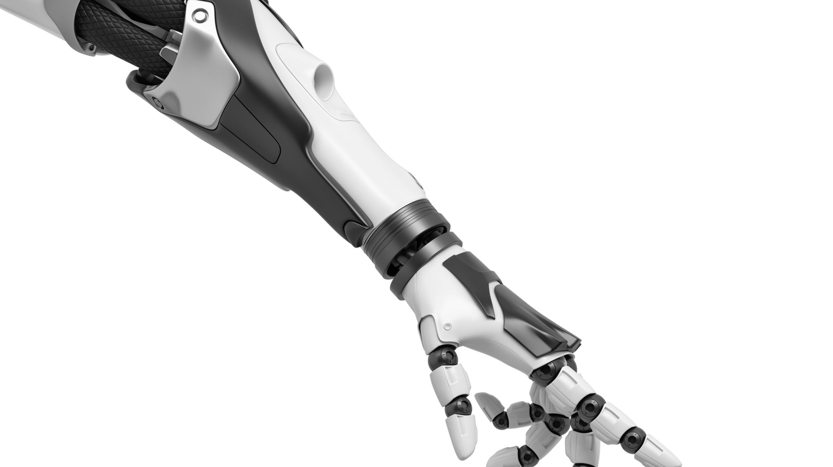
GESTURE CONTROLLED ROBOT
Yuming Wang
Moiz Zaheer Malik
Rubayet Kamal

Slide 2
CONCEPT
Powershell receive Terminal
7 Segment Display
LED
Motors and motor driver
Infrared sensors
FPGA Board (Nexys A7)
Laptop (Windows)
Robot (ESP32)
Accelerometer
Powershell send Terminal
Bluetooth chip
BT2 PMOD

Slide 3
FPGA Board Configuration
ADXL362 Accelerometer.
7 Segment Display.
LEDs.
BT2 PMOD.

Slide 4
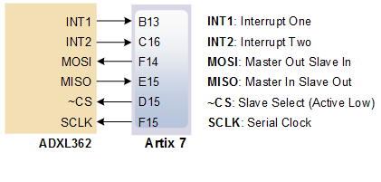
ADXL362

Slide 5
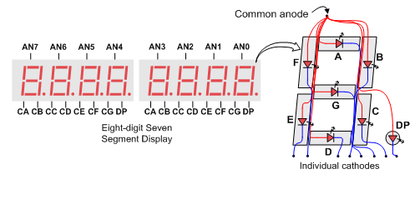
7 Segment Display

Slide 6
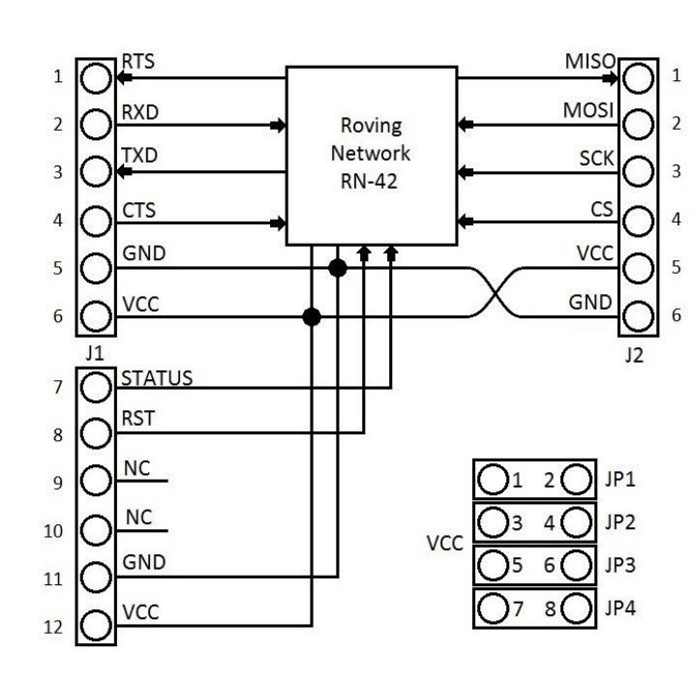
BT2 PMOD
9600 Baud rate setup

Slide 7
Role of VIVADO
Custom IP creation.
Top IP wrapper.
Constrain file mapping.
Bit file generation.

Slide 8
Custom IPs
ADXL362.
BT2 PMOD.
Microblaze.
Wrapper.

Slide 9
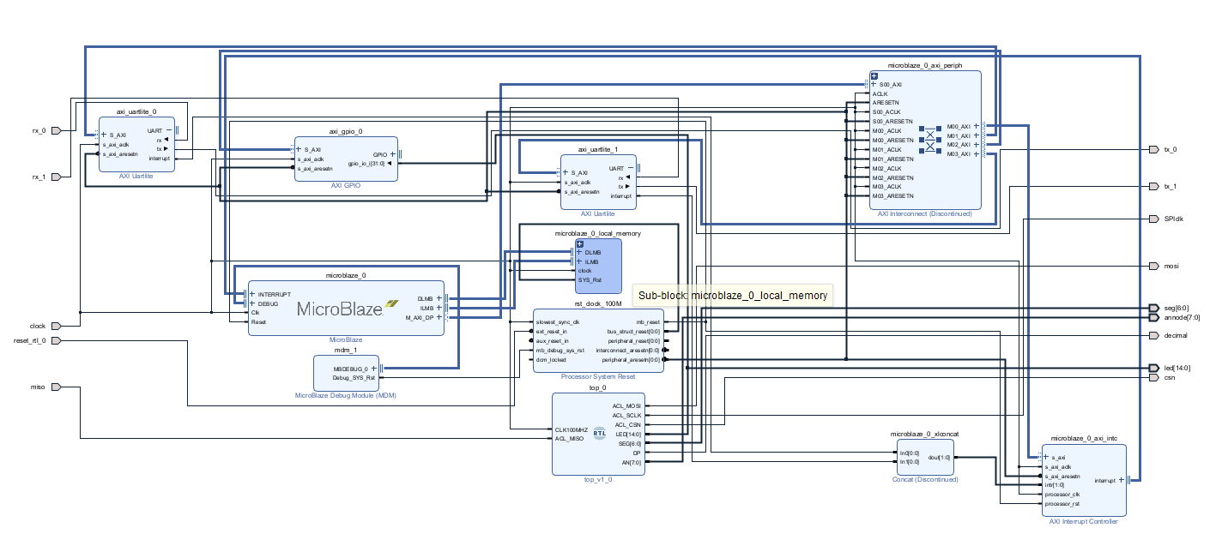
Schematic

Slide 10
Role of VITIS
UART1: PC <-> FPGA
UART2: FPGA <-> BT2 PMOD
Calibration of acceleration.
Configuration of bluetooth.
Sending speed to laptop via bluetooth.

Slide 11
Bluetooth configuration in VITIS
$$$
SN,MY_BT2\r
Bluetooth commands
XUartLite_Send(&BtUart, (u8 *)"$$$", 3);
XUartLite_Send(&BtUart, (u8 *)"SN,MY_BT2\r", 10);
XUartLite_Send(&BtUart, (u8 *)"SM,0\r", 5);
XUartLite_Send(&BtUart, (u8 *)"---\r", 4);
XUartLite_Send(&BtUart, (u8*)"BT2 READY\r\n", 11);
SM,0\r
---\r

Slide 12
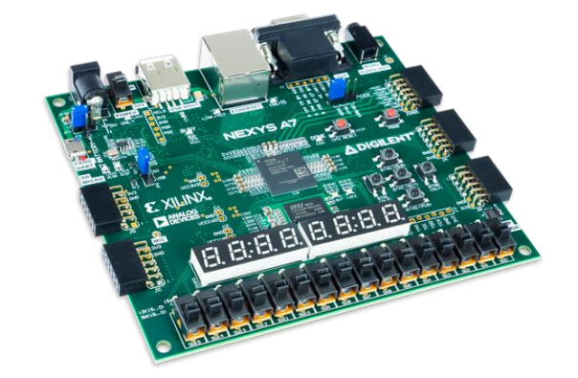

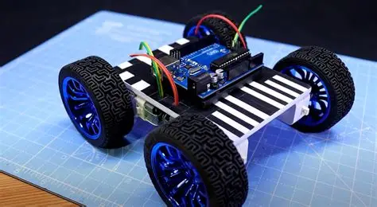
THE BRIDGE
Powershell/ Ubuntu terminal commands
Powershell receive commands
Powershell terminal implementation.

Slide 13
Powershell receive commands
Create and configure serial port
{New SerialPort(COM5, 9600, None, 8, One)}
Start
Initialize settings
{Set COM port = COM5,
Set baud rate = 9600 }
Open Port
End
No
Port opened?
Yes
Yes
Stream Data
Error?
No

Slide 14
Powershell forward commands
Create source and destination SerialPort
Initialize variables
{srcCom = COM5,
baudSrc = 9600,
dstCom = COM6, baudDst = 9600 }
Open Source and destination Ports
Start
End
No
Port opened?
Yes
Yes
Stream Data
Error?
No

Slide 15
THE ROBOT
ESP32 WROOM.
Motors and motor driver.
Infrared sensors.
Bluetooth configutation.

Slide 16
ROBOT LOGIC
No
Constant speed
Hold accelerometer
Tilted?
Acceleration
Yes
- angle
Plane
Angle positive?
Yes
+ angle
FPGA Board
No
Deceleration

Slide 17
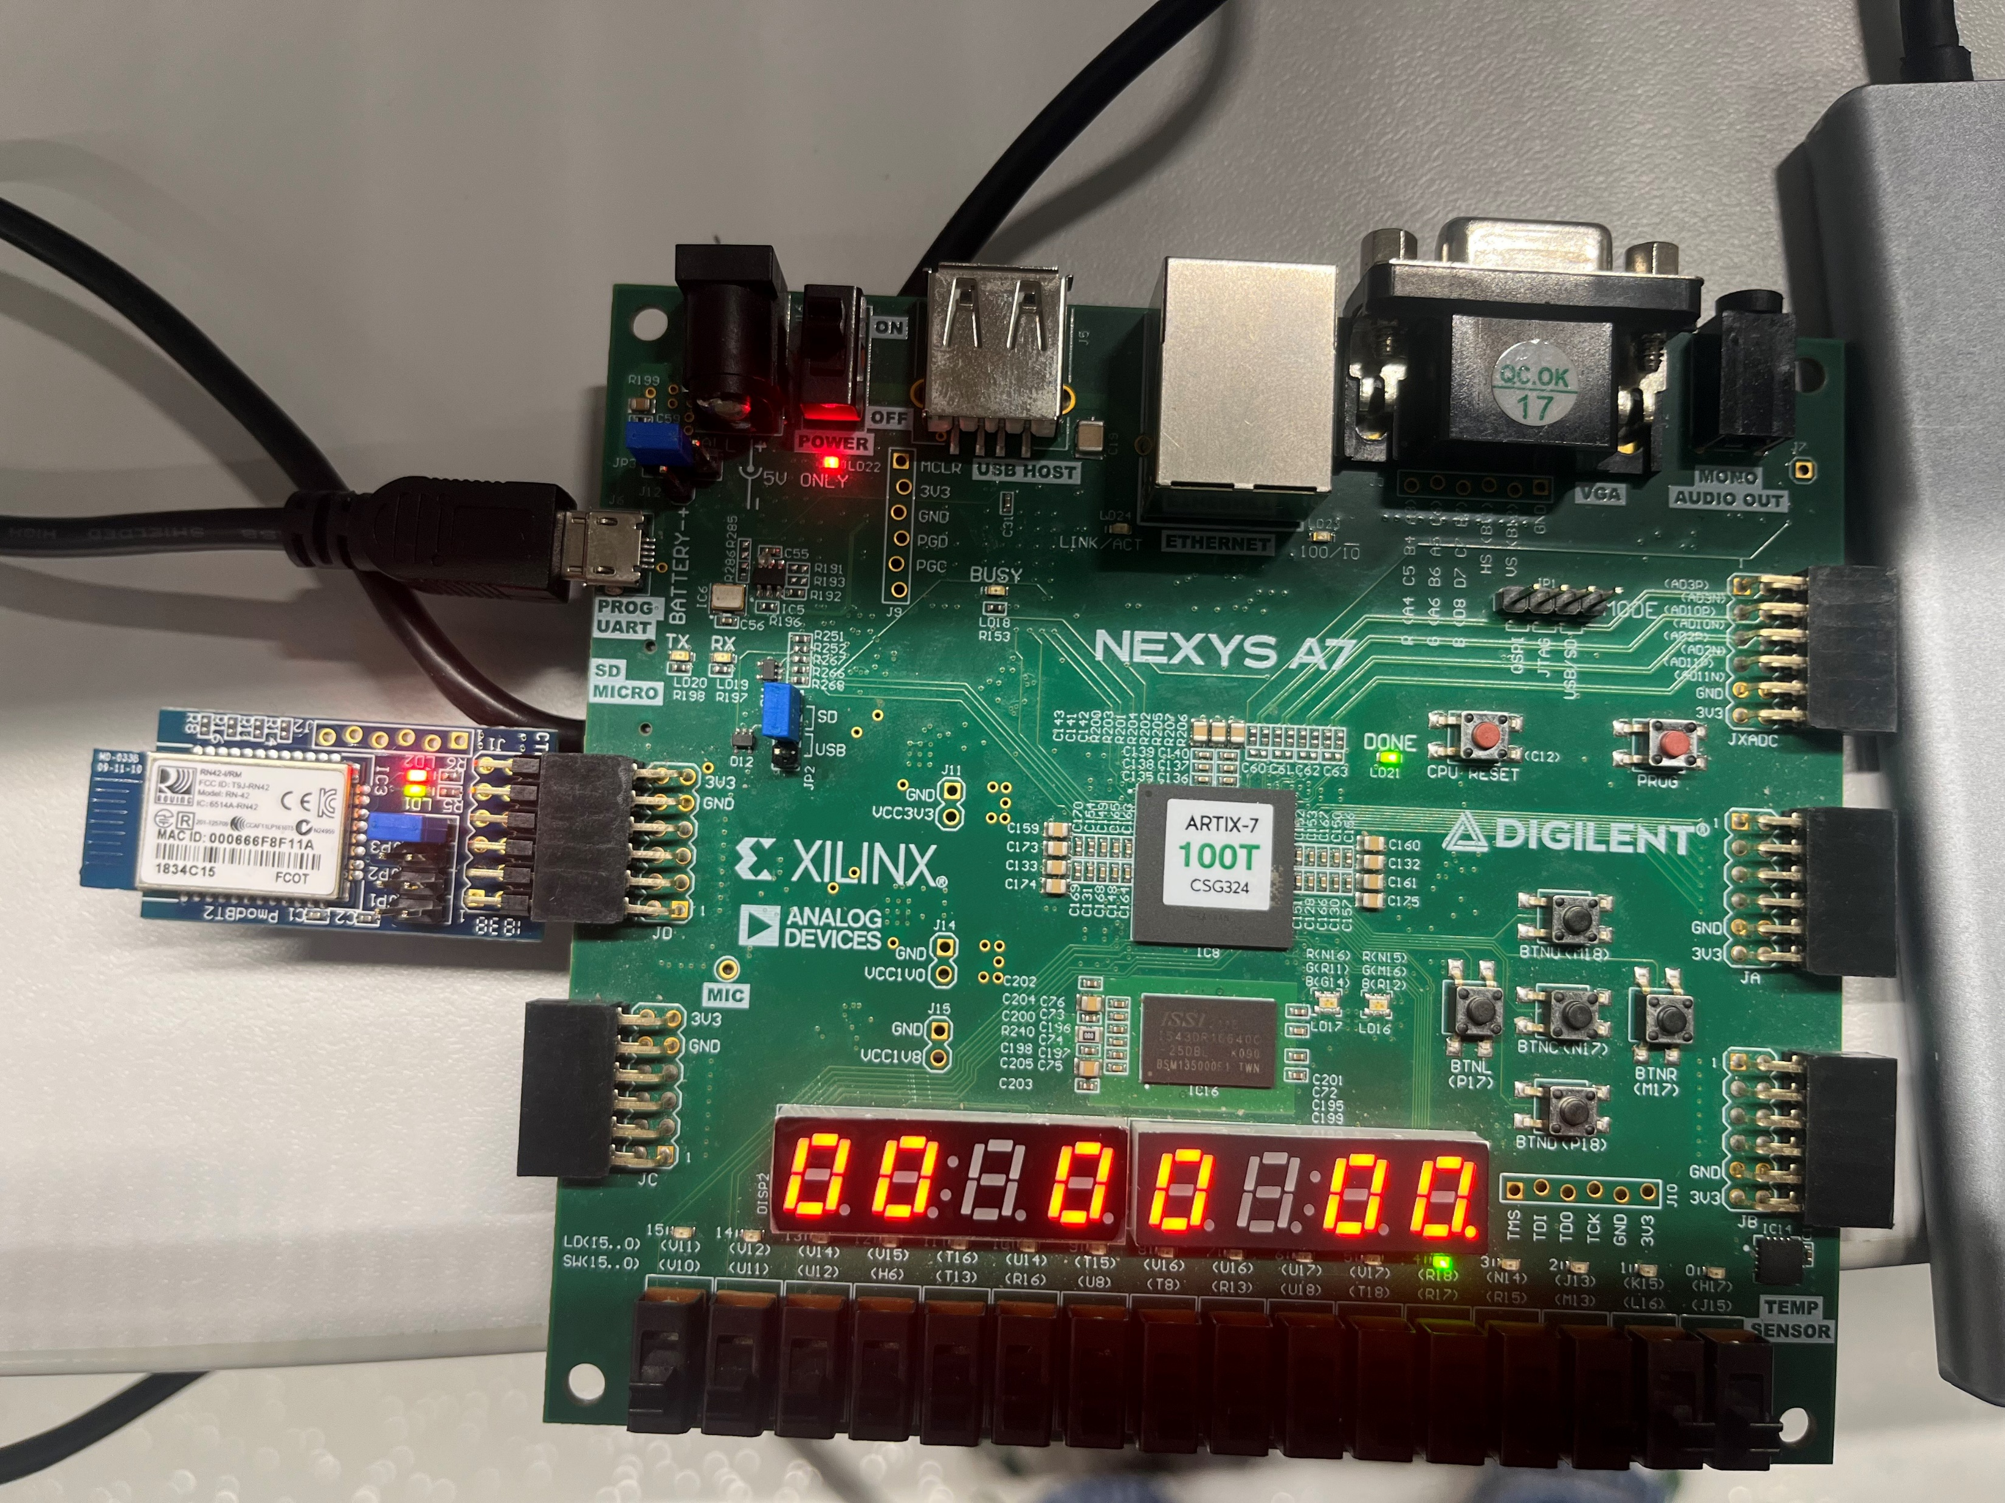
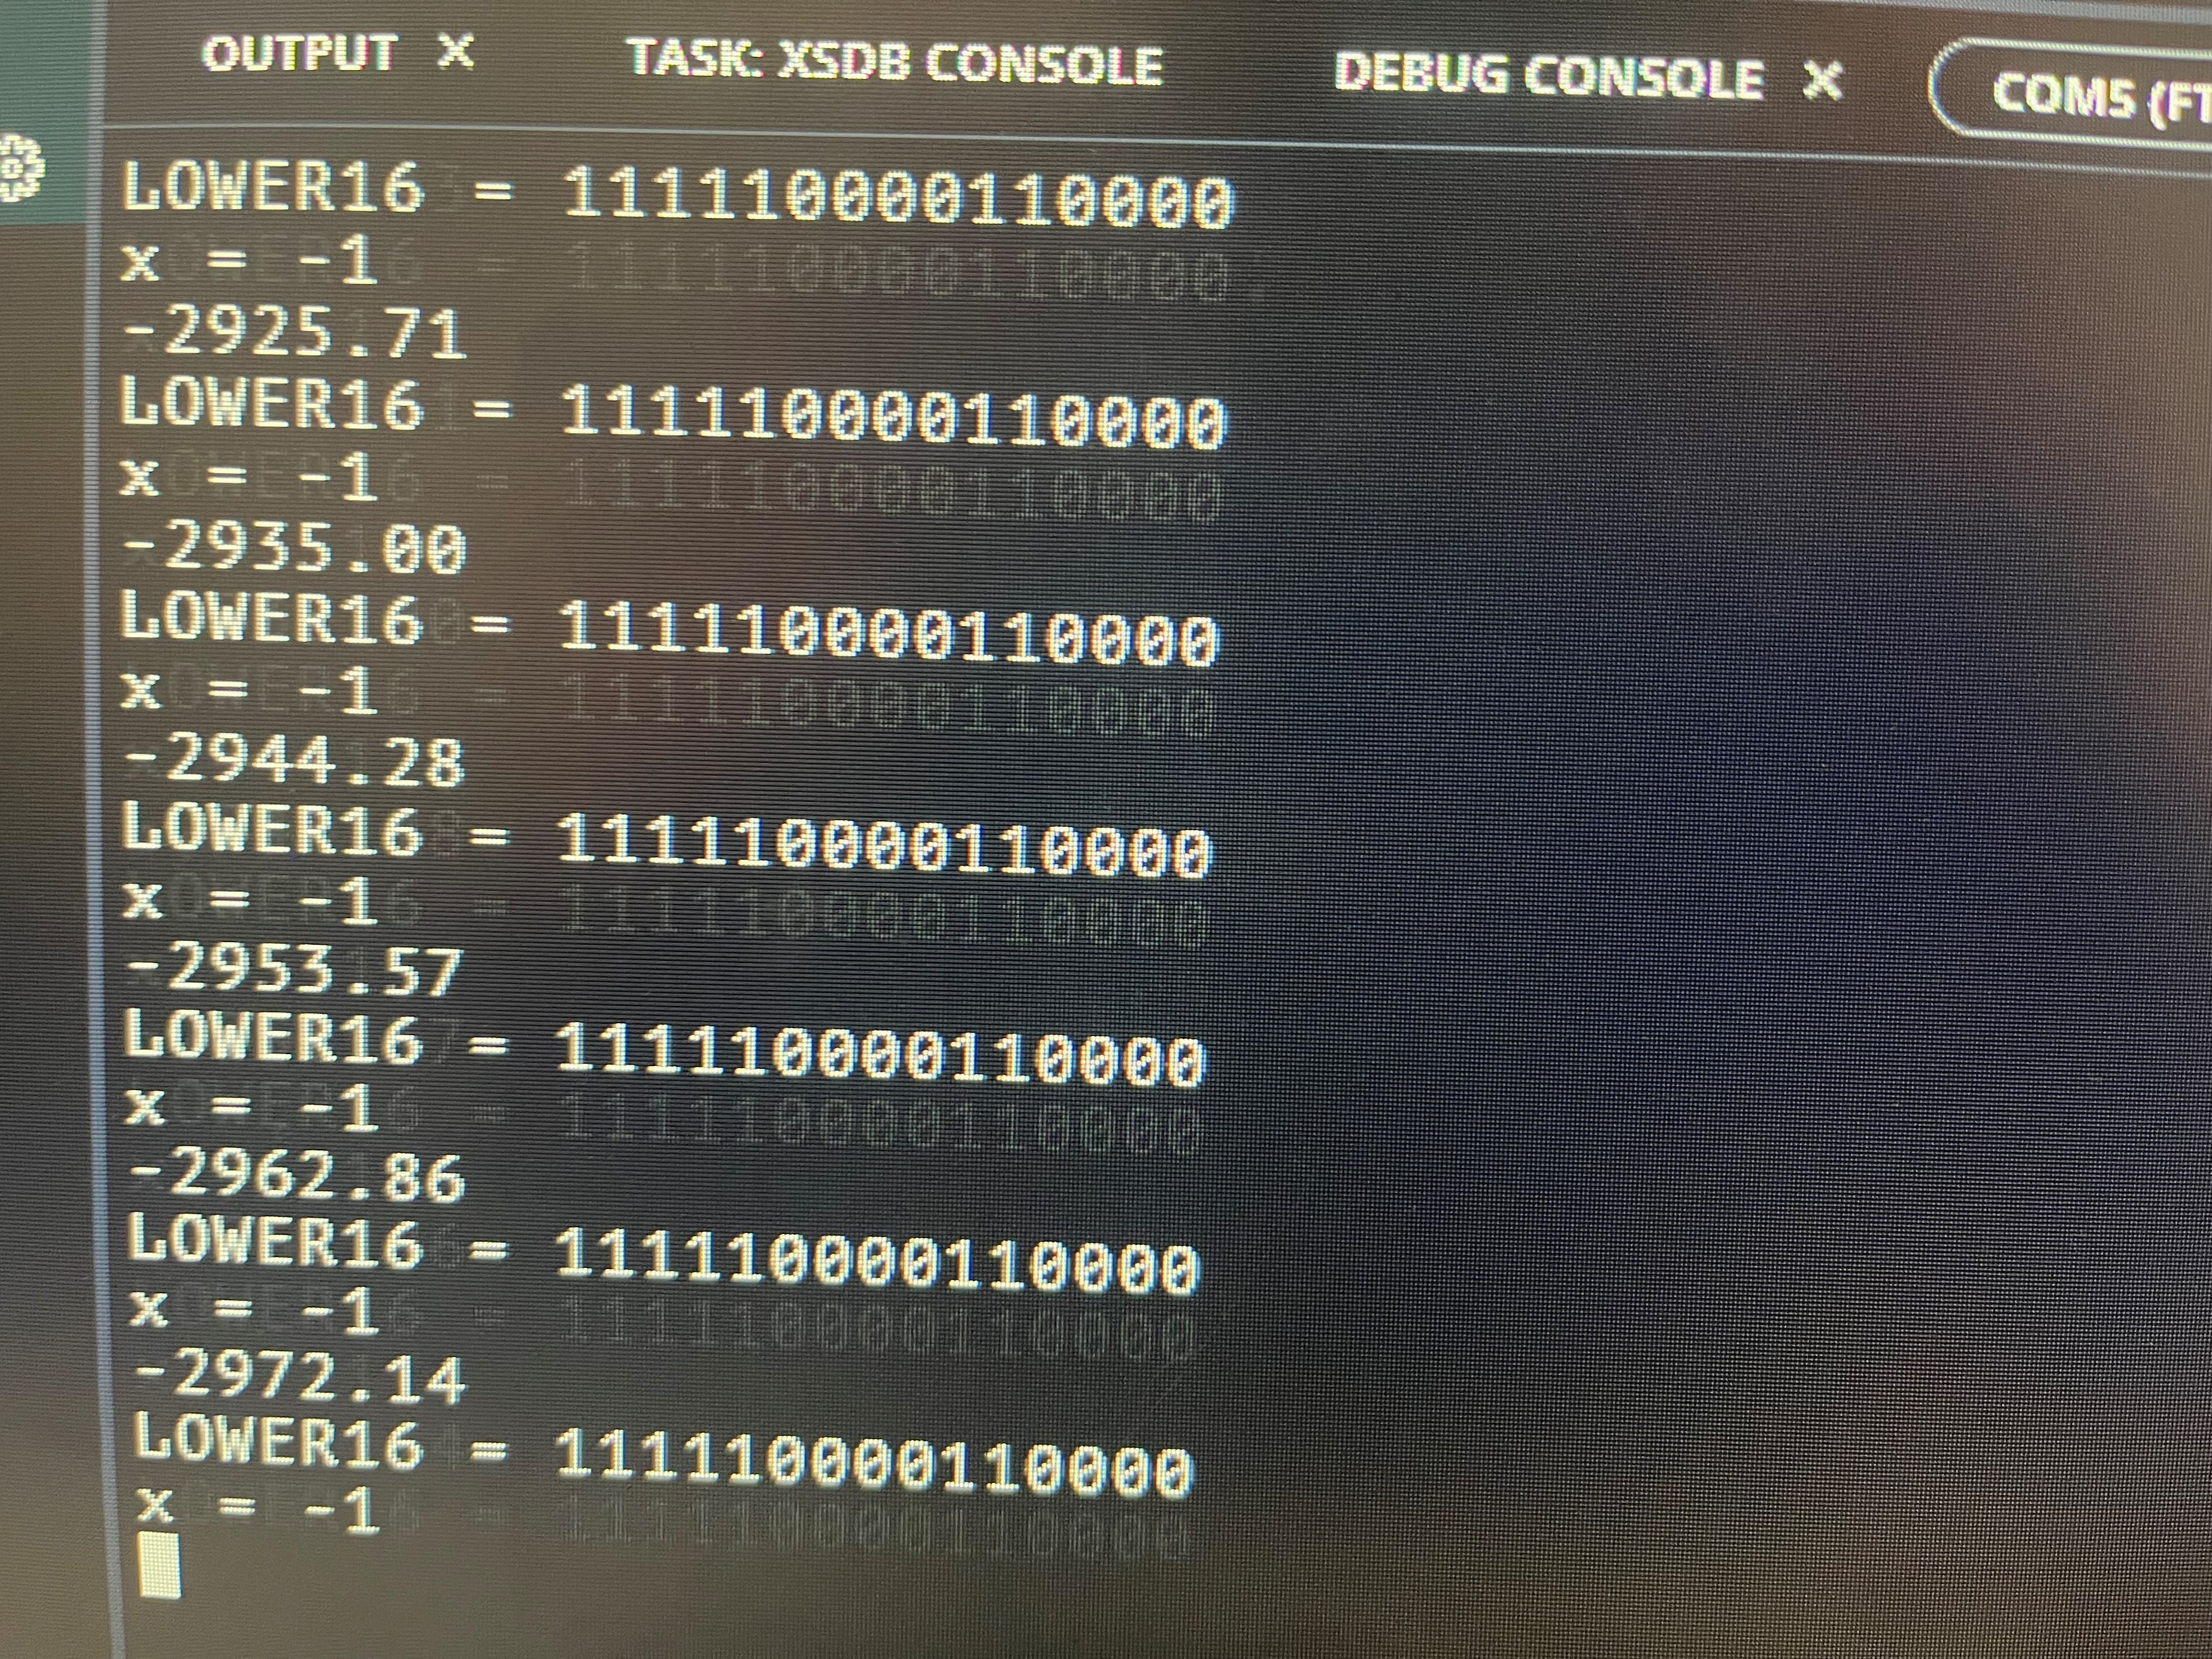
THE BIG PICTURE
Binary bits from accelerometer
Sign bits
The working coordinate
Speed

Slide 18
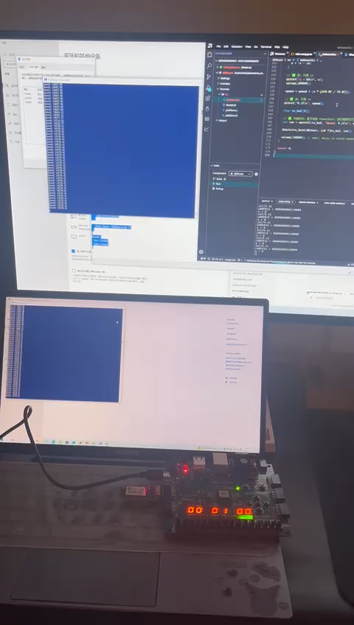
Working Example

Slide 19
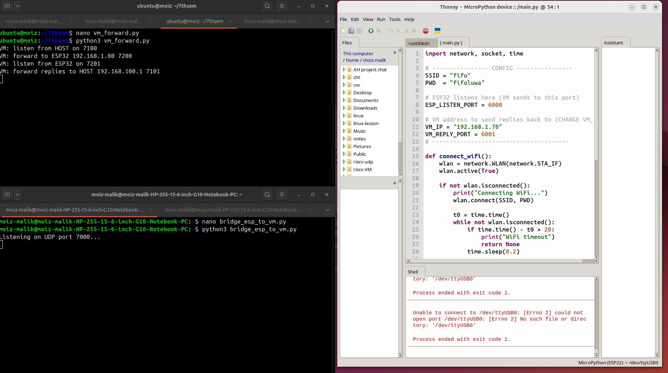
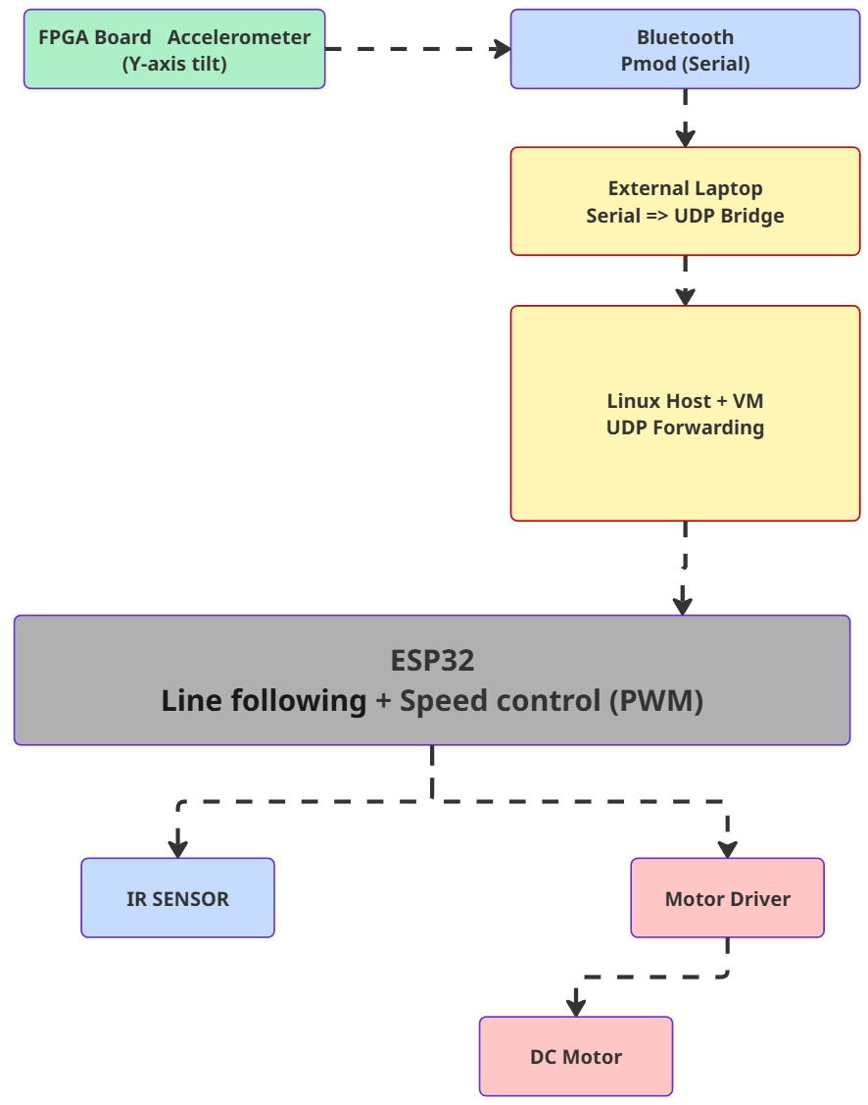
Alternative Approach

Slide 20
Conclusion
What worked:
FPGA Accelerometer reading.
BT2 PMOD data transfer.
ESP32 data received.
Future Work:
BT2 data reading by ESP32 over WiFi.
Car to use the data as velocity.
Integration of other dimensions.
Different robot ideas such as drones, arms, etc.

Slide 21
References
VIVADO (multiple versions).
VITIS (multiple versions).
Arduino IDE.
Thonny.
ChatGPT.
Github.

